Slide 1








Let’s Play!
A Policies & Procedures Jeopardy Game

Slide 2

How to Play
1
Each team will rotate the buzzer holder every round
5
Whichever team answers correct will get to choose next category and point value
Team to go first will be decided by coin flip; once question is read in its entirety, the first team to buzz in will get to answer.
The game continues until all questions in all categories have been chosen and answered correctly. The team with the most points wins!
2
6
3
Each team has 20 seconds to discuss before the buzzer holder must give their final answer
7
Now, let the game begin!
4
If the answer is correct, they earn points.
If not, the opposing team has a chance to “steal” for 1/2 the point value

Slide 3










Happy Residents
Maintenance Manual
Leasing Manual
Policies and Procedures
Making a Friend
100
100
100
100
100
200
200
200
200
200
300
300
300
300
300
400
400
400
400
400
500
500
500
500
500

Slide 4





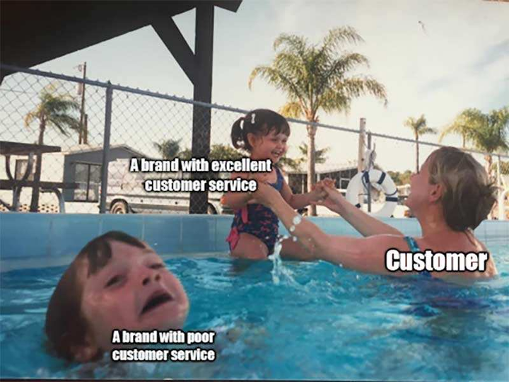
100
Back to Game Board
Happy Residents
Name 3 items that should be given to a new move in.

Slide 5
200
Back to Game Board
Happy Residents
Besides Happy Residents, what are at least 4 benefits to creating an environment for happy residents.

Slide 6
300
Back to Game Board
Happy Residents
List 5 reasons our resident questionnaires and surveys are
important.

Slide 7
400
Back to Game Board
Happy Residents
Name 5 important steps done throughout the lease term that contributes to our renewal process.

Slide 8
500
Back to Game Board
Happy Residents
List 5 Resident
Questionnaire/Surveys
that are sent out
via email to residents.

Slide 9




100
Back to Game Board
Maintenance Manual
What is the
purpose of Michelson’s
STOP
door tag?

Slide 10
200
Back to Game Board
Maintenance Manual
Name at least 3 items
that should be done
during Apartment
Preventative
Maintenance.

Slide 11
300
Back to Game Board
Maintenance Manual
Name at least 4 items
that should be done
during Exterior
Preventative
Maintenance.

Slide 12
400
Back to Game Board
Maintenance Manual
Name at least 6
maintenance
emergencies.
BONUS 50 Points: how quickly should on call tech arrive for emergency call

Slide 13
500
Back to Game Board
Maintenance Manual
Name at least 4
work order priorities
that must be
completed before the
end of the day.

Slide 14



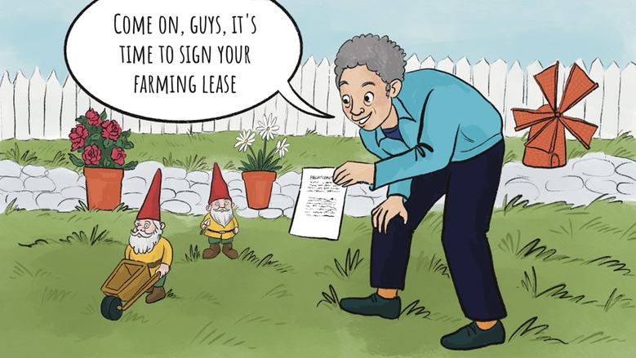
100
Back to Game Board
Leasing Manual
Name 3 factors
included in a
market study.

Slide 15
200
Back to Game Board
Leasing Manual
Besides a caller’s basic
needs and interests,
name 3 things we
should also learn.

Slide 16
300
Back to Game Board
Leasing Manual
Name the 4
personality types.

Slide 17
400
Back to Game Board
Leasing Manual
“Hot buttons” are a part of the
prospect’s personality that
might modify their logical
decision-making. Name three
examples of a hot button.

Slide 18
500
Back to Game Board
Leasing Manual
Name all of the
protected classes
under the
Fair Housing Act.

Slide 19



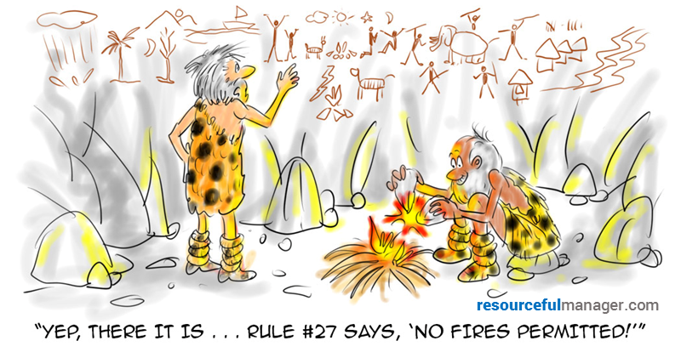
100
Back to Game Board
Policies & Procedures
Name 2 scenarios
that allow us to
give a key to a
resident’s immediate
family or friends.

Slide 20
200
Back to Game Board
Policies & Procedures
Name the Qs
of the
Michelson Mission.

Slide 21
300
Back to Game Board
Policies & Procedures
When is it permissible
for cash to be handled
in the office?

Slide 22
400
Back to Game Board
Policies & Procedures
Name the process
to handle and remove
a derelict vehicle.

Slide 23
500
Back to Game Board
Policies & Procedures
Name 3 examples
of preventative risk management.

Slide 24


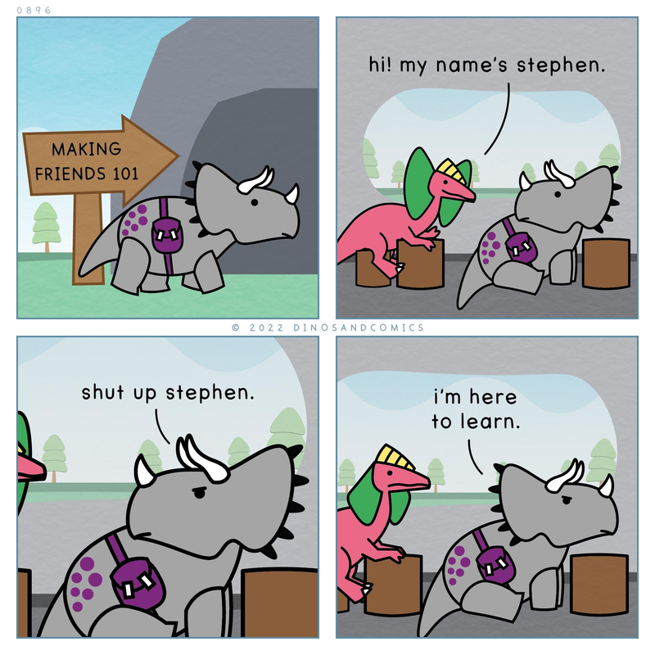
100
Back to Game Board
Making A Friend
Name all requirements
we must meet
to hit the Summit

Slide 25
200
Back to Game Board
Making A Friend
List 4 examples of
“unreasonable hospitality”
we can utilize to make
a friend/engage in
our prospective or
current residents.

Slide 26
300
Back to Game Board
Making A Friend
What are 3 qualities that
can make you
successful at
Engaging Leasing.

Slide 27
400
Back to Game Board
Making A Friend
Name at least 4
important factors to
engage with prospects
that are not ready to
fill out an application.

Slide 28
500
Back to Game Board
Making A Friend
What 5 services
can you provide
to ensure effective
resident retention

